Slide 1

Clarusway Group Mentoring
(Week 2)

Slide 2
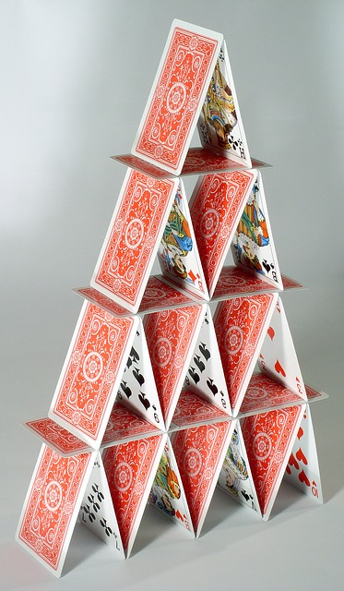



Floor | Base | Roof | Total
1 | 0 | 2 | 2
2 | 1 | 6 | 7
3 | 3 | 12 | 15
4 | 6 | 20 | 26
5 | 10 | 30 | 40
1
2
F: Floor B: Base R: Roof T:Total
B =
3
R =
T = B + R =
4

Slide 3
Floor | Base | Roof | Total
1 | 0 | 2 | 2
2 | 1 | 6 | 7
3 | 3 | 12 | 15
4 | 6 | 20 | 26
5 | 10 | 30 | 40
1
2
F: Floor B: Base R: Roof T:Total
Pseudocode-1
f = INPUT “Enter floor count”
CALCULATE b = f X (f-1)/2
CALCULATE r = f X (f+1)
CALCULATE t = b + r
PRINT “Cards needed for ” f “is:”
PRINT b “pieces for Bases”
PRINT r “pieces for Roofs”
PRINT t “pieces total”
3
4
Notes:
Python notebook code

Slide 4
Pseudocode-2
SET card_limit = 104 # 2x52 pieces
SET f = 1
SET t = 0
WHILE t <= card_limit
BEGIN
b = f X (f-1)/2
r = f X (f+1)
t = b + r
f = f + 1
END
fm = f – 1
used_cards = (3*fm*fm + fm)/2
remaining_cards = card_limit – used_cards
PRINT “Using ” card_limit “cards”
PRINT “Maximum floor is ” fm
PRINT “Needed card count is” used_cards
PRINT remaining_cards “cards will remain”
1
2
3
4

Slide 5
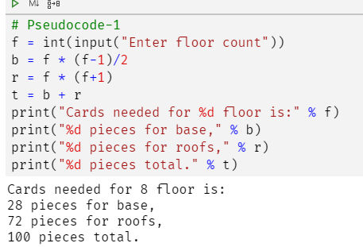
# Pseudocode-1
f = int(input("Enter floor count"))
b = f * (f-1)/2
r = f * (f+1)
t = b + r
print("Cards needed for %d floor is:" % f)
print("%d pieces for base," % b)
print("%d pieces for roofs," % r)
print("%d pieces total." % t)

Slide 6
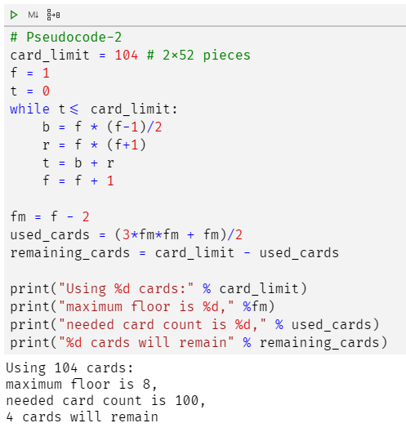
# Pseudocode-2
card_limit = 104 # 2x52 pieces
f = 1
t = 0
while t<= card_limit:
b = f * (f-1)/2
r = f * (f+1)
t = b + r
f = f + 1
fm = f - 2
used_cards = (3*fm*fm + fm)/2
remaining_cards = card_limit - used_cards
print("Using %d cards:" % card_limit)
print("maximum floor is %d," %fm)
print("needed card count is %d," % used_cards)
print("%d cards will remain" % remaining_cards)

Slide 7
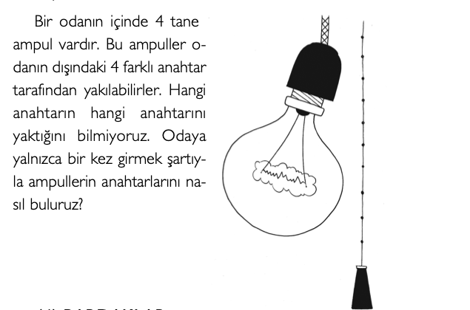
QUESTIONS
Warm up Questions:)

Slide 8
QUESTIONS
Scrum rolleri nelerdir? Kısaca açıklayınız

Slide 9
QUESTIONS
Epic nedir ? Örnek veriniz?

Slide 10
QUESTIONS
Scrum’da geçen ceremoniler(meetingler) nelerdir? Kısaca açıklayınız

Slide 11
QUESTIONS
Product Backlog nedir?

Slide 12
QUESTIONS
What is the parts of the Compuational Thinking? Please explain briefly.

Slide 13
QUESTIONS
Server nedir? Server tipleri nelerdir? Kısaca açıklayınız

